Slide 1
CSCI 580 Discussion
Week 8 – HW5
Rongqi Qiu
rqiu@usc.edu

Slide 2
HW4
Regrading for HW1 - 3
One-time regrading opportunity
Please write your requests in README.txt along with your HW4 submission
No regrading requests will be accepted since HW4
Make sure you submit on time
Double check that no file is missing
Double check that the package compiles on its own

Slide 3
HW4
Clarification on flat shading in HW4
It’s optional
Two methods to implement
Like in HW3, use render->flatcolor set by GZ_RGB_COLOR attributes;
Compute normals of triangles and apply shading equations
Both are OK

Slide 4
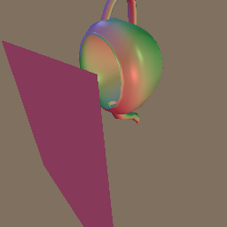
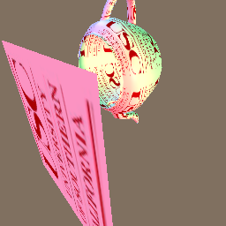
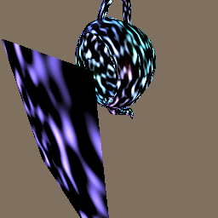
HW5 – Overview
Adding texturing capabilities to your renderer
HW4
Color specified by material attributes
HW5
Color specified by images
Color specified by functions

Slide 5
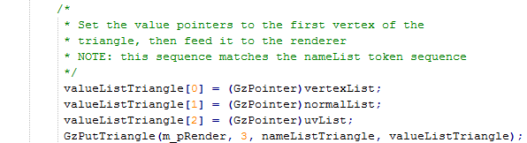
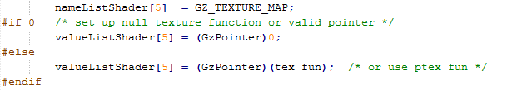
HW5 – Overview
Application5.cpp
Texture coordinates (u, v)
Texture function

Slide 6


HW5 – Overview
Application5.cpp
Texture coordinates (u, v)
Mapping from surface points to texture coordinates (u, v)
Image texture (tex_fun)
or
Procedural texture (ptex_fun)
Texture function

Slide 7
HW5 – Outline
Texture coordinates: surface point → (u, v)
Input: vertex → (u, v)
Replace (fixed) material color for (variable) texture color
Texture functions: (u, v) → RGB
Image texture
2D RGB image (look-up table)
Procedural texture
General computing functions

Slide 8
HW5 – Outline
Texture coordinates: surface point → (u, v)
Input: vertex → (u, v)
Replace (fixed) material color for (variable) texture color
Texture functions: (u, v) → RGB
Image texture
2D RGB image (look-up table)
Procedural texture
General computing functions

Slide 9
HW5 – Texture Coordinates (GzPutTriangle)
Assume we have defined a texture function
tex_fun(u, v) → RGB
Two remaining problems:
How to apply texture at vertices of triangles?
How to apply texture at interior of triangles?

Slide 10
HW5 – Texture Coordinates (GzPutTriangle)
Assume we have defined a texture function
tex_fun(u, v) → RGB
Two remaining problems:
How to apply texture at vertices of triangles?
How to apply texture at interior of triangles?

Slide 11
HW5 – Texture Coordinates (GzPutTriangle)
How to apply texture at vertices?
Retrieve (u, v) at this vertex (from input)
Call tex_fun to retrieve RGB color
What to do with retrieved RGB color?
Phong shading: Ka, Kd
Gouraud shading: Ks, Ka, Kd
We will explain this choice in the next slides

Slide 12
HW5 – Texture Coordinates (GzPutTriangle)
Assume we have defined a texture function
tex_fun(u, v) → RGB
Two remaining problems:
How to apply texture at vertices of triangles?
How to apply texture at interior of triangles?

Slide 13
HW5 – Texture Coordinates (GzPutTriangle)
Texture coordinates (u, v) are given only at vertices, but interior points need (u, v) too.
Solution: interpolation!
Similar to interpolating Z (during rasterization), RGB color (during Gouraud shading) and normal vectors (during Phong shading).
Either LEE or scan-line is fine.
Note: perspective correction (Class7, Slide 14)

Slide 14
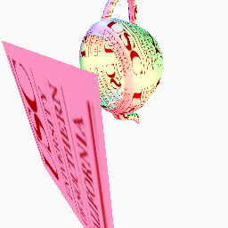
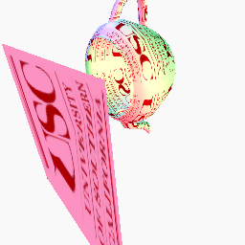
HW5 – Perspective Correction
perspective correction no perspective correction

Slide 15
HW5 – Perspective Correction
Object Space
World Space
Image Space
Perspective Space
Screen Space
Projection

Slide 16
HW5 – Perspective Correction
Object Space
World Space
Image Space
Perspective Space
Screen Space
Projection

Slide 17
HW5 – Perspective Correction
Object Space
World Space
Image Space
Perspective Space
Screen Space
Projection
This is where (u, v) is given.
This is where pixels are drawn.

Slide 18
HW5 – Perspective Correction
Object Space
World Space
Image Space
Perspective Space
Screen Space
(u, v)
(U, V)
Projection
(u’, v’)
(U’, V’)

Slide 19
HW5 – Texture Coordinates (GzPutTriangle)
Phong shading C = (Ks Σ_{L} [Ie (R•E)^{s}] ) + (Kd Σ_{L} [Ie (N•L)]) + (Ka Ia)
material attribute (fixed) texture lookup (pixel-by-pixel)
Gouraud shading (set K_{T}=Ks=Kd=Ka) C = (K_{T}) (Σ_{L} [Ie (R•E)^{s}] + Σ_{L} [Ie (N•L)] + Ia)
texture lookup compute at vertices (pixel-by-pixel) and interpolate to pixels

Slide 20
HW5 – Outline
Texture coordinates: vertex -> (u, v)
Given as input per vertex
Used for obtaining (variable) texture color in replacement of (fixed) material color
Texture functions: (u, v) -> RGB
Image texture
2D RGB image (look-up table)
Procedural texture
General computing functions

Slide 21
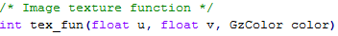
HW5 – Image texture (tex_fun)
Compute RGB color given texture coordinates (u, v)
Returns GZ_SUCCESS or GZ_FAILURE
Boundary test (u,v) within [0,1] x [0,1]
The codes for loading texture files are already given

Slide 22
HW5 – Image texture (tex_fun)
Problem: (u, v) range over [0, 1] x [0, 1], texture image is 2D array of (xs-1) x (ys-1)
Solution: scaling by the size of the texture image
u
x
Image texture resolution ([0, xs-1], [0, ys-1])
u,v coordinates range
([0,1], [0,1])
scale
v
y

Slide 23
HW5 – Image texture (tex_fun)
Problem: what if scaled (u, v) is not integer?
Solution: bilinear interpolation
Color(p) = s t C + (1-s) t D + s (1-t) B + (1-s) (1-t) A
s, t are fractional distances [0,1]
A, B, C, D are RGB colors at neighboring pixels
A
B
t
s
p
D
C

Slide 24
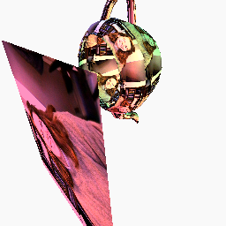

HW5 – Image texture (tex_fun)
Try other texture images!
Just replace the file “texture” with any ppm image.
Rendering using the left texture image
Example texture image

Slide 25
HW5 – Outline
Texture coordinates: vertex -> (u, v)
Given as input per vertex
Used for obtaining (variable) texture color in replacement of (fixed) material color
Texture functions: (u, v) -> RGB
Image texture
2D RGB image (look-up table)
Procedural texture
General computing functions

Slide 26
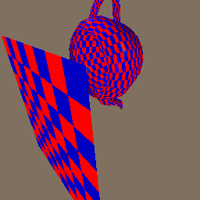
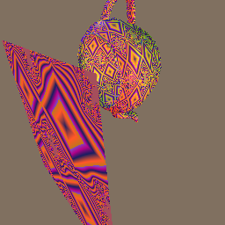
HW5 – Procedural texture (ptex_fun)
Any function of (u,v) is OK as long as a texture pattern is clearly evident.
Use your imagination!

Slide 27
Q & A

